Slide 1
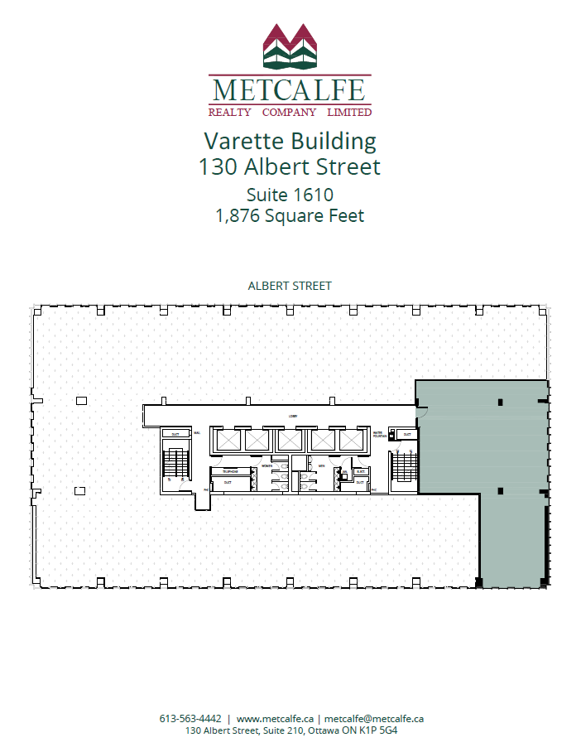
Suite1615
1,705 Square Feet

